Slide 1
Introducing MERLIN 3.0
This presentation, and the attached code/dataset demonstrate MERLIN.
MERLIN is a tool to quickly find all discords in am arbitrary range of lengths.
This is useful for the concrete task of anomaly detection, and general data cleaning for downstream tasks.
This is MERLIN 3.0
  Based on ideas by: Takaaki Nakamura, Makoto Imamura, Eamonn Keogh, Ryan Mercer, Kaveh Kamgar, Dragomir Yankov
  Please note: This is a pre-release, the code is somewhat rough and ready, feedback welcome
  It is fast, but not optimize to death, if you are going to compare times, we would appreciate fairness.

Slide 2
This dataset has a single bad heartbeat, an Atrial premature beat between 13400 and 13800. (For non-experts, this is a beat that happens early, and corresponding, the following beat is longer) By most standards, this is a subtle anomaly.
Early beat
13800
13400
qtdbSel100MLII
1.3
1.35
1.4
1.45
4
10

Slide 3
We could try to find an anomalous beats with time series discords, using the Matrix Profile.
However, the Matrix Profile finds lots of information, including motifs, we only want the top discords.
So let us find just the top-1 discord, this it will be faster than the Matrix Profile.
What length should we use? A good cardiological heuristic would be about ½ a beat to 1 beat (100 to 200 datapoints)
However, lets assume we don’t know that. Let's use all lengths, from 30 to 300.
>> [disc_dist_a, disc_loc_a, disc_nn_loc_a, disc_times, disc_misses] = MERLIN3_0(qtdbSel100MLII, 30, 300, 5, true);
The red dots indicate the location of discords at a particular length.
30
300
The red bars indicate the location of discords at a particular length, and the bar length is the discord length.
30
300
0.2
0.4
0.6
0.8
1
1.2
1.4
1.6
1.8
2
4
10

Slide 4
If we had tried the too-short values, say 30 to 42, we would have found effectively random, slightly nosier than average snippets, but not structurally different shapes.
Likewise for just one longer value, 249, it happens that the discord is at the end of the time series.
However, by looking at the solid line of discords at about 13400, we have no doubt where the true anomaly is.
30
300
0.2
0.4
0.6
0.8
1
1.2
1.4
1.6
1.8
2
4
10

Slide 5
There is another obvious reason to find discords of all lengths, you may have anomalies of multiple lengths.
To see this, I have added a synthetic short anomaly, >> qtdbSel100MLII(400)=0; to our dataset.
As before, a quick inspection reveals the (now two) anomalies.
Embedded anomaly
150
100
50
0
-50
-100
300
350
400
450
500
550
600
30
100
0.2
0.4
0.6
0.8
1
1.2
1.4
1.6
1.8
2
nz = 71
10
4
30
Short artificial anomaly
Long real anomaly
100
0.2
0.4
0.6
0.8
1
1.2
1.4
1.6
1.8
2
10
4

Slide 6
Did we get lucky?
As it happens, the 60,000 datapoints that follow our little example do not have any annotated anomalies, so we can try an 80,000 datapoint version of the problem…
>> [disc_dist_a, disc_loc_a, disc_nn_loc_a, disc_times, disc_misses] = MERLIN3_0(val(1,1:1:80000), 100, 200, 5,true);
We still find the top-1 anomaly to be in the right place.

Slide 7
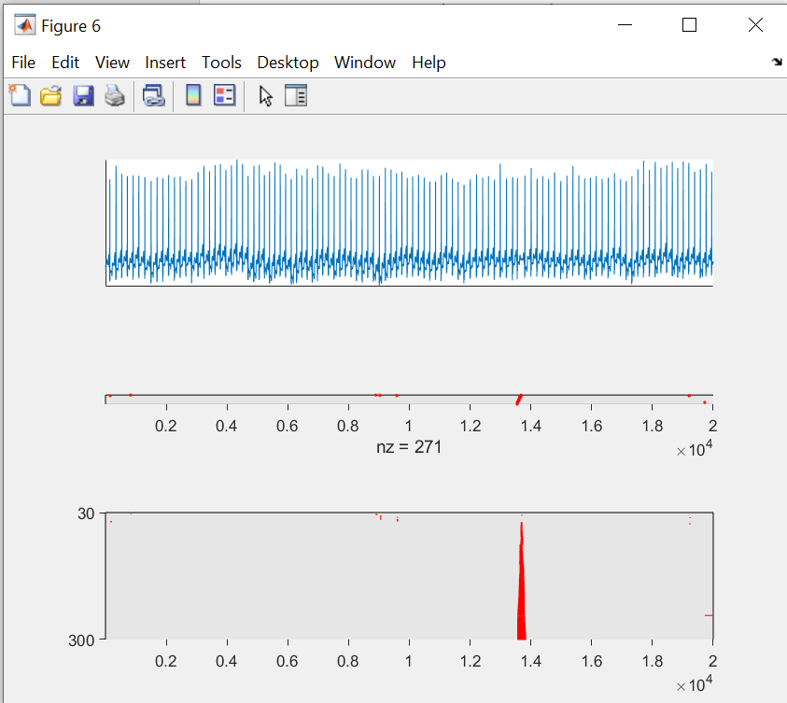
How to
Longest discord you want
Shortest discord you want
IF true: Echo metadata while running
>> load qtdbSel100MLII.txt
>> [disc_dist_a, disc_loc_a, disc_nn_loc_a, disc_times, disc_misses] = MERLIN3_0(qtdbSel100MLII, 30, 300, 5,true);
---
For your time series of length 20000, with a discord of length 30.
Phase 1 took 0.48 seconds, Phase 2 took 0.06 seconds, for a total of 0.24 seconds.
The top discord starts at location 829, and is 5.27 from its nearest neighbor.
---
For your time series of length 20000, with a discord of length 31.
Phase 1 took 0.17 seconds, Phase 2 took 0.01 seconds, for a total of 0.17 seconds.
The top discord starts at location 828, and is 5.68 from its nearest neighbor.
---
(EK, steps omitted)
---
For your time series of length 20000, with a discord of length 298.
Phase 1 took 0.44 seconds, Phase 2 took 0.01 seconds, for a total of 0.45 seconds.
The top discord starts at location 13548, and is 16.47 from its nearest neighbor.
---
For your time series of length 20000, with a discord of length 299.
Phase 1 took 0.44 seconds, Phase 2 took 0.01 seconds, for a total of 0.45 seconds.
The top discord starts at location 13548, and is 16.49 from its nearest neighbor.
---
For your time series of length 20000, with a discord of length 300.
Phase 1 took 0.44 seconds, Phase 2 took 0.01 seconds, for a total of 0.45 seconds.
The top discord starts at location 13547, and is 16.52 from its nearest neighbor.
This is you guess to what the discord distance will be for the shortest discord. You will get the same results for any guess, but a good guess will make the algorithm a little faster.

Slide 8
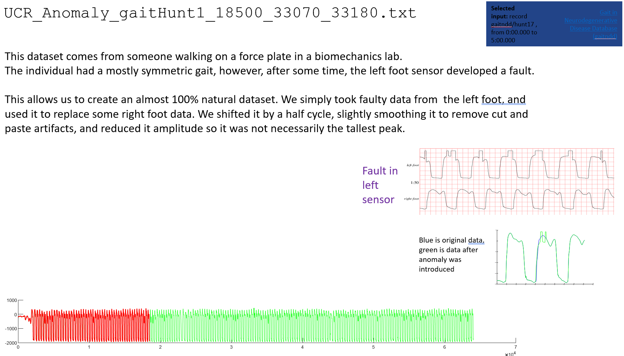
Lets try one more dataset, this one: 170_UCR_Anomaly_gaitHunt1_18500_33070_33180.txt
The anomaly should be at location 33070-18500 = 14570.
By a visual inspection, we guess somewhere in the 100 to 200 length, lets try it…
>> [disc_dist_a, disc_loc_a, disc_nn_loc_a, disc_times, disc_misses] = MERLIN3_0(UCRAnomalygaitHunt1185003307033180(18500:end), 100, 200, 5, true);
For your time series of length 45501, with a discord of length 100.
Phase 1 took 0.50 seconds, Phase 2 took 0.05 seconds, for a total of 0.55 seconds.
The top discord starts at location 14601, and is 8.77 from its nearest neighbor.
---
>> disc_loc_a(end)
ans =
14588
Start here, to ignore training data.
Pretty close to 14570
100
Some errors at the short end of our range…
..but overall, successful
200
0.5
1
1.5
2
2.5
3
3.5
4
4.5
4
10

Slide 9
Please Read
There are trivial ways to make discords look bad, by finding or contriving the data.
However, there are equally trivial fixes. Please do not report results based on such trivialities
1. Twin Freak: An anomaly appears twice with the same shape. Thus, the nearest neighbor distance from one to the other is small, and they are not the discord.
Unbelievably, someone got a KDD paper ^{[1]} by fabricating such data www.cs.ucr.edu/~eamonn/discord_sigkdd.pdf
Solution: You can find the nearest neighbor only to the left, then the first occurrence will be a discord^{[2]}. Or you can generalize to the k^{th} nearest neighbor.
2. Anomalies that are manifest in extraordinarily large changes in values.
At least some of the YAHOO, NASA and SDM (Dan Pei) datasets have anomalies that are manifest as values that change by many orders of magnitude. Discords, which z-normalize, may have a hard time finding these. However, such anomalies can almost always be found in linear time with a single line of matlab! Consider the example to the right, red is ground truth. Lets predict with..
>> plot((real2(1:end,2) > mean(real2(1:end,2)) + (2* std(real2(1:end,2))) )-3,'g’);
Counting these as a success for your algorithm is dubious, papers written in the 1950’s could solve these problems.
Here dog is discord
catcatdogcatcat
But not here
catcatdogcatcatcatcatdogcatcat
20
15
10
Yahoo real 2
(Excerpt)
5
0
1320
1340
1360
1380
1400
1420
1440
^{[2]}I think this is the second worst time series paper in SIGKDD, and a useful cautionary tale about peer review. ^{[2]}In fact, online monitoring requires this.

Slide 10
MERLIN 3.1
Fix Constant Region Problems I & II
New feature for MERLIN 3.1
July 30, 2021
Ryan Mercer
Discords can fail for both the Constant Region problem and the Near Constant Region problem (defined in Appendix A)
In MERLIN 3.0, we have added a feature to address these.
These are pathological problems and easy to handle in several ways. However, we now include a simple solution in MERLIN 3.1
Please note that MERLIN 3.1 has slightly different input and output parameters.

Slide 11
Usage
There is an anomaly..
But there are flat regions that are longer than the anomaly!
T:
minLength = 30;
maxLength = 300;
verboseOutput = true;
>>[distances, indices, lengths] = MERLIN3_1(T, minLength, maxLength, verboseOutput)
It is OK, MERLIN 3.0 can handle this..

Slide 12
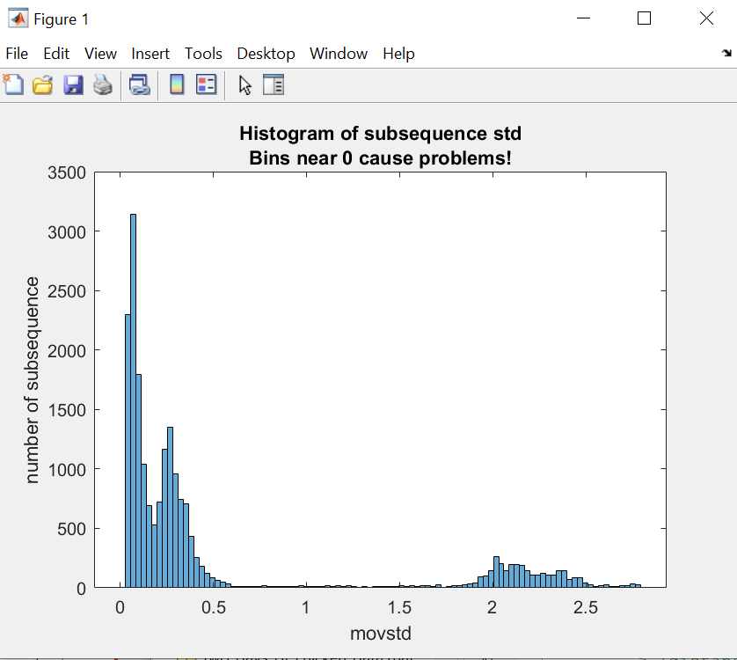
User Prompt
The histogram has 100 bins. Bins always start at 0
If any non-zero values in the first five bins, the user is prompted.
Here the strong “spike” bin zero suggests you choose ‘y’
T:
>>[distances, indices, lengths] = MERLIN3_1(T, 30, 35, true)
!!!!!!!!!!!!!!!!!!!!!!!!!!!!!!!!!!!!!!!!!!!!!!!!!!!!!!!!!!!!!!!!!!!!!!!!!!!!!!!!!!!!!!!!!!!!!!!
!!! MERLIN may report false positive anomalies in subsequences with near constant values.
!!! A sign that the problem exist is a spike near zero when plotting the histogram of movstd.
!!! Adding a large linear trend will solve this issue.
!!! Proceed with data modification? [y/n]
Here the fact that the first bin is not the largest, and you have a smoother distribution suggests you choose ‘n’.

Slide 13
Fixing Constant Region Problems I & II
Adding a large trend dominates all features visually.
The transformation is not interesting to look at, so it is not plotted
function [T2] = preprocessTimeSeries(T, w)
TMean = nanmean(T);
TSTD = nanstd(T);
TNorm = (T - TMean)/TSTD;
dataSlope = (1:length(T));
T2 = TNorm(:) + dataSlope(:);
end
Anomaly
Type I
Type II
200
Constant
Region
Error
30
region
containing
anomaly
300
200
400
600
800
1000
1200
1400
1600
1800
2000
2200
Constant
Region
Fixed
30
300
200
400
600
800
1000
1200
1400
1600
1800
2000
2200

Slide 14
MERLIN MERLIN3_1 is faster than the old version.
Please use it, if you need to report times.
It is not especially optimized code. If you further optime it, please let us know.

Slide 15
Appendix A
The Constant Region Problem
The (near) Constant Region Problem

Slide 16
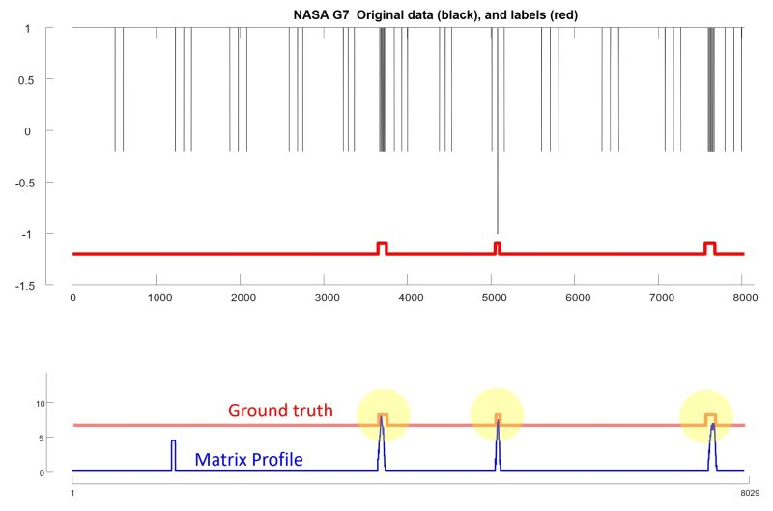
The Constant Region “Problem”
Some datasets, like this NASA G7 dataset, have constant regions that are longer than the subsequence length.
Recall that we normally compute discords in z-normalized space, so a constant region is undefined (div-zero).
What actually happens depends on the implementation.
For the MP implementation used here, the MP profile does have undefined regions, and the largest value is a false positive ;-(
We can fix this elegantly in the MP code. However, to show how simple it is to fix this, let me show you this “hack” trick.
I am going to add a tiny (1 part in a million) linear trend to the data, like this:
>> interactiveMatrixProfileVer4_website( G7 +[1:length(G7)]'/1000000 ,50);
That completely solves the problem, and the top three discords are now all true positives.
The latest version of MERLIN 3.1 does this automatically for you. For the Matrix Profile, you should do it yourself.
10
Blank regions are undefined
5
0
10
5
Problem solved!
0
8029

Slide 17
The (near) Constant Region “Problem”
1
5001
Consider this simple dataset, where we correctly find the PVC anomaly
>> interactiveMatrixProfileVer4_website( edbECG(11000:16000) ,200);
Now let me prepend some very low amplitude noise. It is so low amplitude that it looks almost constant, but it is not a true constant.
Here is a zoom-in
Now the low amplitude region is the anomaly.
What happened?
When you z-normalize the very low amplitude noise it “expands” in amplitude, like this ->
Such high amplitude noisy regions are maximally far from all other subsequences (including other high amplitude noisy subsequences).
Such very low amplitude near constant regions are common in many datasets. However, such regions are also trivially easy to detect and remove. The latest version of MERLIN 3.1 does this automatically for you. For the Matrix Profile, you should do it yourself.
25
Top discord
20
15
10
5
0
1
5001
very low amplitude noise
1
5501
25
New top discord
20
15
10
5
0
1
5501
100
80
60
40
plot(movstd(x,200))
20
0
0
1000
2000
3000
4000
5000
>> x=[rand(1,500) edbECG(11000:16000) ]; % detect
>> x((movstd(x,200)<1))=[]; % removed
>> interactiveMatrixProfileVer4_website( x ,200);
Problem solved
20
1
5100
10
0
1
5100
A real world example of this can be found in trace 3 of https://github.com/NetManAIOps/OmniAnomaly/blob/master/ServerMachineDataset/test/machine-3-10.txt

Slide 18
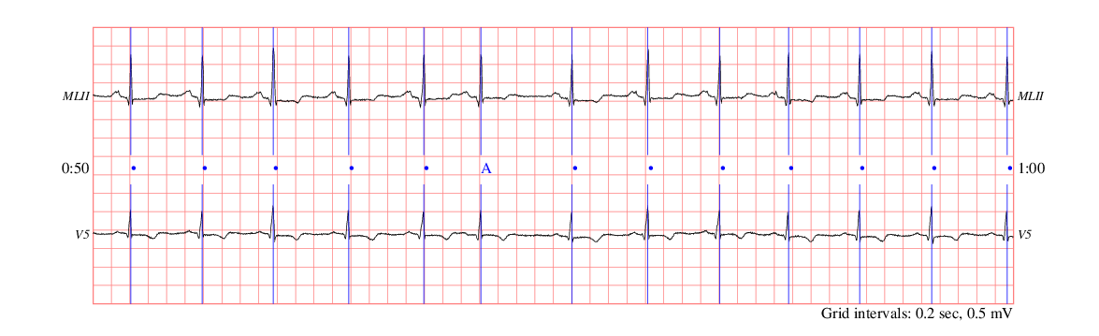
For provenance
https://archive.physionet.org/cgi-bin/atm/ATM
pschart -a atr -c "" -C -E -G -CG 1 .5 .5 -Cs 0 0 0 -H -l -P 300x250 -m 20 20 5 5 -M -n 0 \ -S 4 2 -t 25 -T "" -v 10 -w 0.5 script >chart.ps
convert -density 100x100 chart.ps chart.png
Selected input: record qtdb/sel100 , annotator atr , from 0:50.000 to 1:00.000 | QT Database (qtdb)
Atrial premature beat

